Slide 1
High pressure water jetting /hydro blasting AWARENESS
Attachment-3
Reference standard : SHEM 08.07
Oct 2021

Slide 2
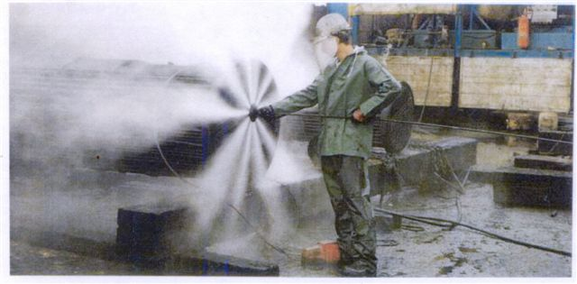
HIGH PRESSURE WATER JETTING (HPWJ) OPERATIONS
Hydrojetting/ high pressure water jetting (HPWJ) / hydoblasting is a hazardous operation.
Water pressure produced by the HPWJ/hydroblasting equipment are normally in excess of 250 psig and can be as high as 30,000 psig
Hydroblasting operations should be analyzed, prepared and performed according to SHEM 08.07“High Pressure Water Jetting”.

Slide 3
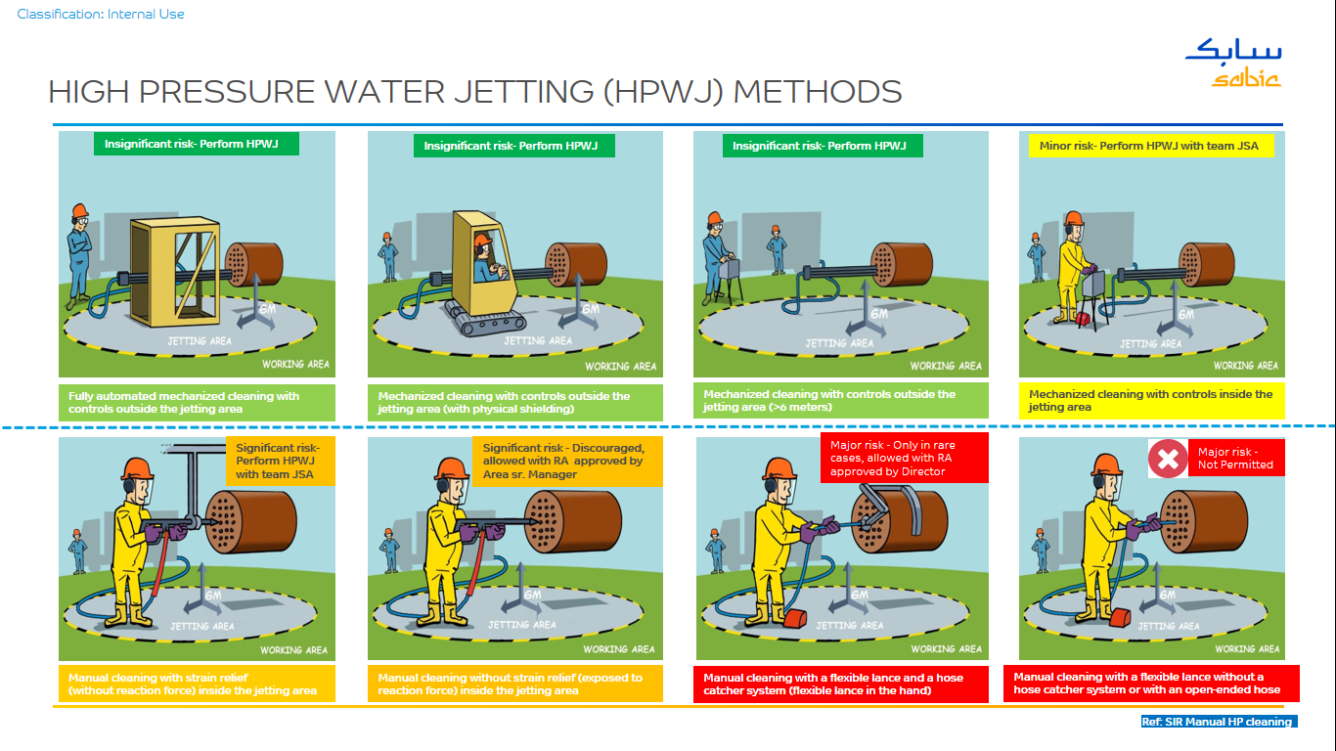
HIGH PRESSURE WATER JETTING (HPWJ) OPERATIONS
Hierarchy of risk Control:
Automated and semi automated HPWJ methods shall be considered before manual lancing fitted with an anti-withdrawal/ejection device, since they avoid exposure of personnel to high pressure and are more safe.
See Table 4.1 for typical risk evaluation

Slide 4
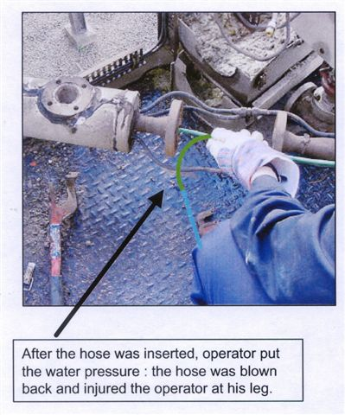
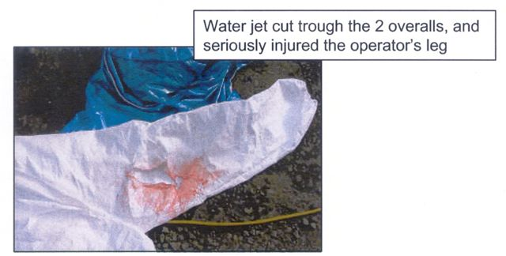
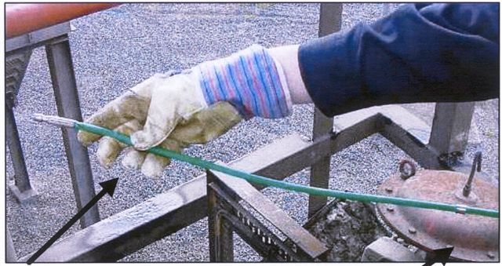
HIGH PRESSURE WATER JETTING (HPWJ) OPERATIONS – What can happen ?
…But it needed to be inserted up to this point to avoid blow back when pressure is powered
Hose was inserted up to this point….

Slide 5
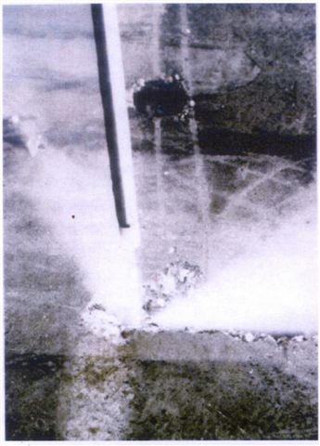
HPWJ OPERATIONS – MOST HAZARDOUS WORK ?
A HP water jet (from the nozzle or from a leak) could easily perforate or cut off a part of the body
HP water jetting wounds are always serious; quick destruction of deeper tissues & development of infection
Disconnected hoses or uncontrolled nozzle could whip and hit with high velocity, resulting in serious fractures or contusions.
Slips and falls (wet floor, kickback of the nozzle…), electrical incidents (water jet hitting electrical device..), noise…
Burst protection sleeves ( hose shroud) shall be used when the hose connects to a hand held device and should be long enough to offer protection to the operator in eth event of a hose failure or leak at the connection.
Hose restraining devices of the correct rating shall be used as protection against coupling failure.
HP jet of water perforating Concrete (can cause serious injury)

Slide 6
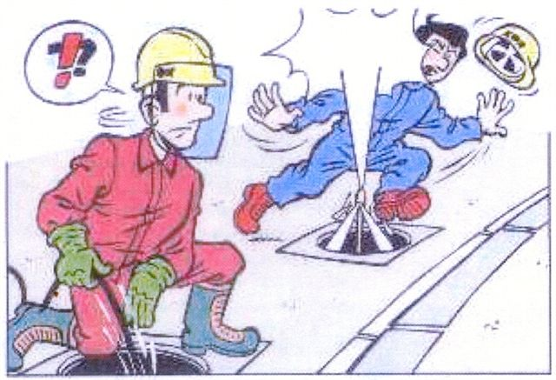
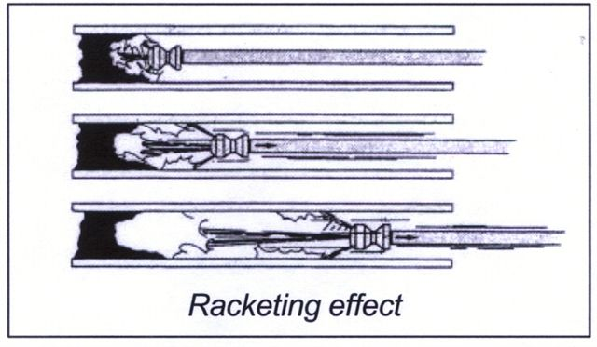
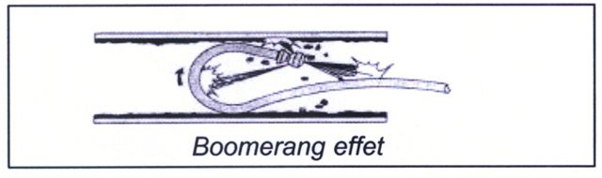
HPWJ OPERATIONS – HOW these incidents are happening?
Many incidents happened using HPWJ in various cleaning/ surface preparation activities.
Consequences resulted from near misses up to fatalities.
Experience shown that the use of hose with end-nozzles is particularly tricky.
Jetting gun shall be a minimum of 1.1 meter long for standard applications
Consider the length of jetting gun to reduce the risk of contact with water jet, especially when jetting floors.
Short jetting guns with two triggers shall be used with caution by experienced qualified HPWJ operators after hazard controls.

Slide 7
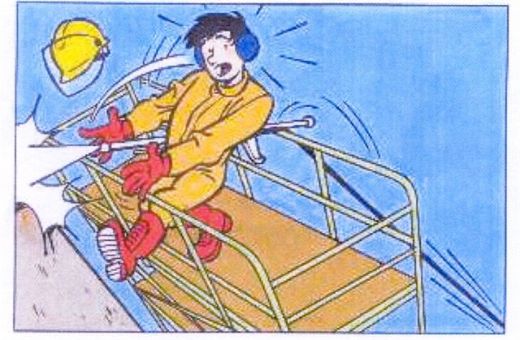
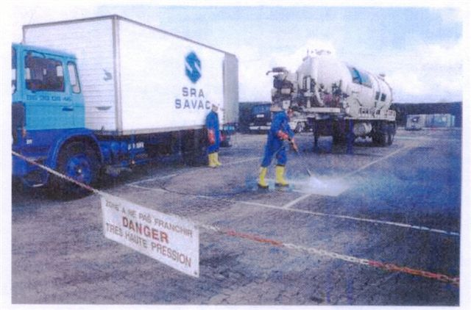
HPWJ OPERATIONS – be prepared before using !
Be prepared before using!
Work with HPWJ is not a common task.
Refer to procedure SHEM 08.07 for details.
Key to success and safety is preparation
Consider back thrust from HPWJ, so need stable footing and platform (HPWJ standing on Ladders and process equipment/pipelines are prohibited)
Points to be focused:
Use only by qualified and certified personnel
Check devices before use (pump, pressure regulation, hoses, coupling, nozzle etc..)
Barricade the area with signage that indicates HPWJ operation in progress

Slide 8
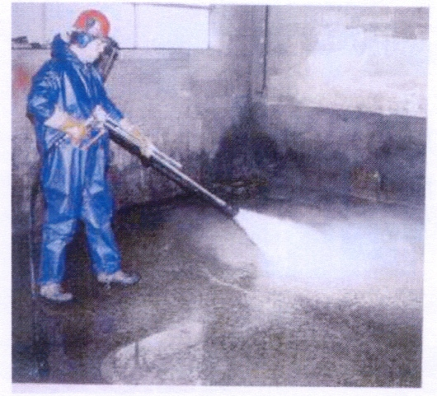
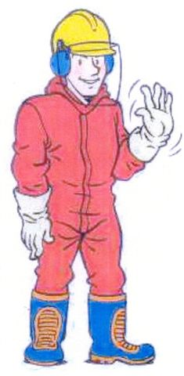
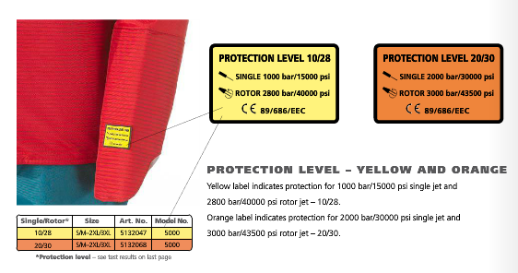
HPWJ OPERATIONS – PONTS TO BE FOCUSED
The HPWJ operator and those within the jetting area wear PPE :
Hard hat,
Safety glasses with side shield,
Face shield,
Hearing protection,
PPE suit for the required HPWJ pressure,
Rubber gloves,
Rubber boots with metatarsal protection,
Other PPE as required if chemicals are involved

Slide 9
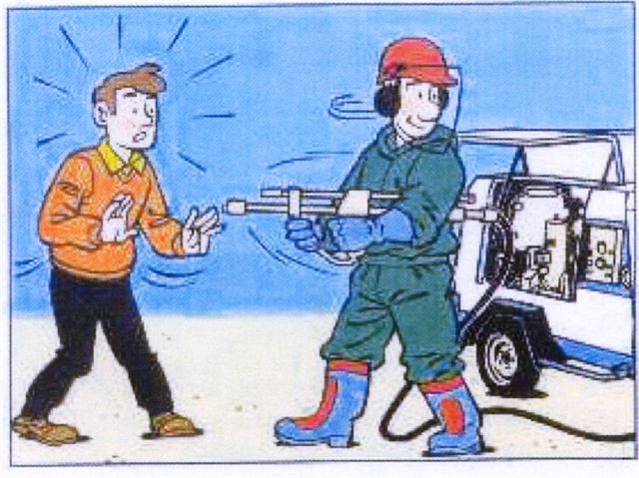
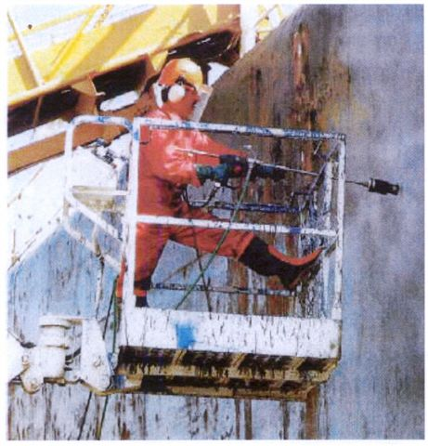
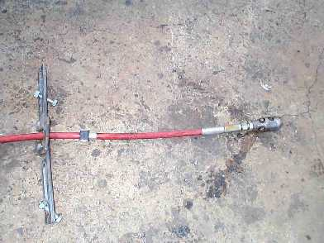
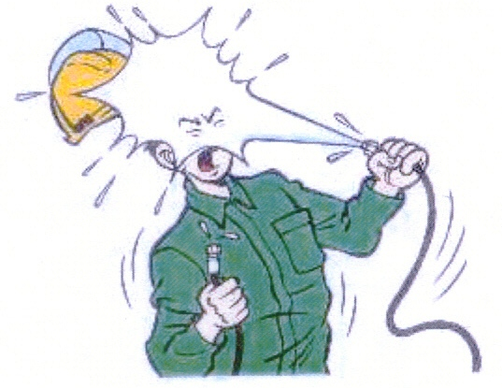
HPWJ OPERATIONS – PONTS TO BE FOCUSED
Anti-withdrawal
device
Tube
nozzle
Use HPWJ work permit.
A safety device (anti-withdrawal) is used to prevent the hose assembly from being pulled out of the tube or pipe while equipment is energized or pressurized.
Minimum two persons as work crew. Stop HPWJ in case of unauthorized entry.
Use hand guards in all lancing operations
High-pressure
hose
Restraining
Clamp
Typical Anti-Withdrawal Device Setup
(prior to tube inspection)

Slide 10
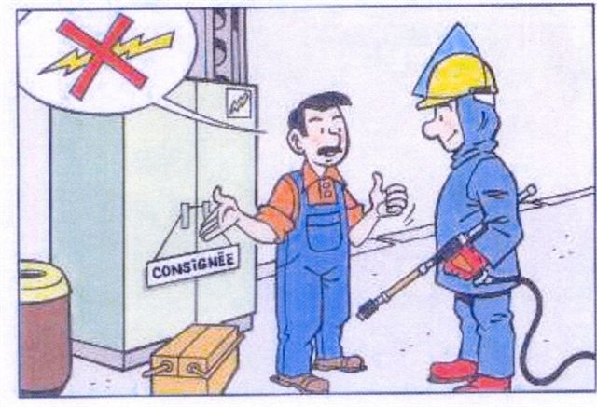
HPWJ OPERATIONS – PONTS TO BE FOCUSED
Sensitive equipment ( e.g. Electrical Panels) must be protected from water generated by the operation

Slide 11
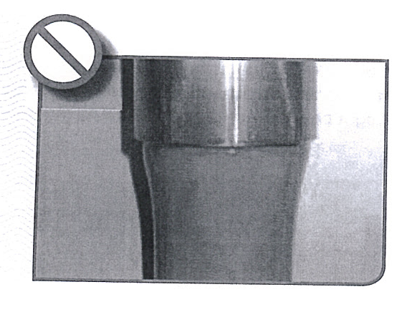
HPWJ OPERATIONS – HOSES
Pulling in loops produce Kinks, which weakens the hose
Avoid temperature extremes on hoses
Re-ending of HP hoses prohibited
TEST regularly and INSPECT before use as a unit ( with couplings, whip checks…)
Correctly stored hoses
Kinked hose
Stretched hose
Damaged hose
ATT-9 HPWJ equipment details
Use hose feed guide to protect from sharp edges
Squashed hose
Twisted hose

Slide 12
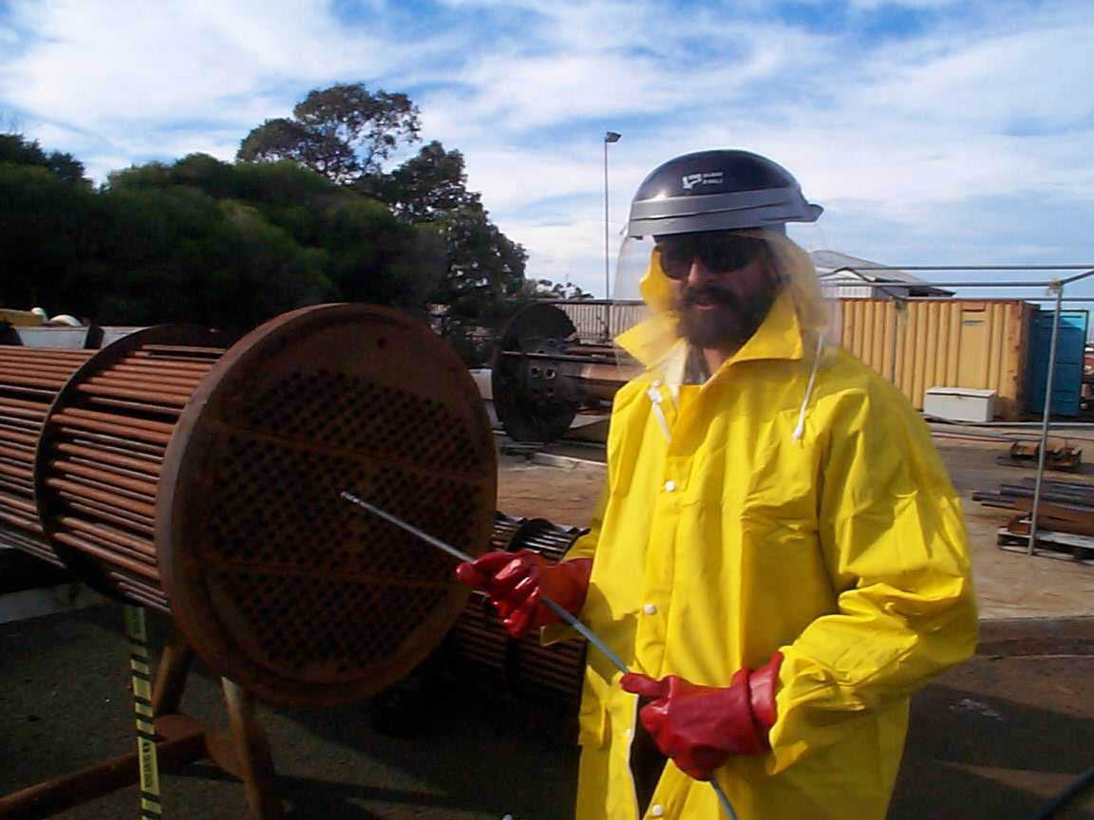
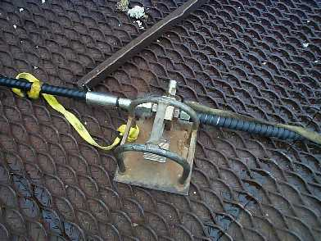
HPWJ OPERATIONS – Specific to lancing
Hose restrainers
Foot pedal
Foot Pedal with Hose Restrainer
Exchanger Tube Bundle Cleaning (Flex-lancing demonstration)
An easily visible marker shall be affixed two feet from the nozzle end of the lance to indicate nozzle location as the line is being inserted or withdrawn from the tube being cleaned (mark is placed on the hose and not the lance). High pressure shall be applied to the nozzle only when the lance is in the tube.
While moving the lance from one tube to the next, the water pressure should be reduced to less than 200 psig. This makes moving the lance easier and reduces exposure to the cutting action of the jets.
When hand held lancing the use of an anti-withdrawal/ejection device and lance guard shall be used.

Slide 13
HPWJ OPERATIONS – DO’s
DO’s
Undertake a formal JSA for all HPWJ activities and provide a Technical specification Contact the HPWJ authorizing person on the plant, obtain necessary permits and note special precautions. Erect barriers/tape off the working area at the safe distance and erect warning signs. Ensure that the water supply is adequate Check fluid levels on engine, gearbox and pump (lubrication oil, fuel and water) Lay out equipment and visually inspect it for damage (hoses, connections etc.), ensure all equipment is suitably earthed. Assemble equipment, checking all joints and ensuring whip restraint devices are fitted Ensure filters are clean. Fully prime equipment and bleed where necessary. Fit guns, lances and control valves correctly; visually check that correct size, type of nozzle and fittings are correct for the application. When cleaning of heat exchanger tubes, with long lance equipment always ensure a coloured tape marker or similar is fixed on the lance at 1 meter from the nozzle tip, in order to alert the operator to release pressure before completely withdrawing the hose from the tube on the return path. Increase pressure slowly until operating conditions are reached. Re-check hose couplings and joints for leaks. Rectify all leaks ensuring that the unit is shut down and line pressure released before making any adjustments. Ensure that all operatives are wearing required PPE (as specified on the work Permit and as required by the JSA). Regularly rotate team members’ positions to minimise fatigue. Regularly check operating conditions (oil, water pressure, condition of filters, pipe work, hoses.) Ensure that all pressure in lines is released on any shutdown. On completion strip down equipment and store in a clean condition. Clear the site of barriers, warning signs and debris to the satisfaction of the Permit Issuer On completion sign off all permits

Slide 14
HPWJ OPERATIONS – DONT’s
DONT’s
Commence work on site without the necessary permission and permits. Commence any jetting operation until warning signs are on show and the area is roped off. Operate without required PPE for eyes, head, ears, hands, feet and body. Run any equipment with any leakage whatsoever without rectifying the problem. Attempt to tighten any pressure joint whilst equipment is under pressure e.g. hose coupling, lance, nozzle tightening adjustments Bypass safety cut outs. Fail to check the reasons for ANY malfunction. (Low water, blocked filters, low oil level etc.) Operate with guns and control valves not meeting requirements or functioning correctly (failing to shut off or leaking). Operate guns or control valves with the operating lever tied back, wedged or locked in the “ON” position. Operate with badly worn or undersize nozzles. Continue to operate if any unauthorised personnel enter the operating area. Operate equipment at power levels which can produce a reaction force greater than the operative can comfortably absorb. Leave equipment running unattended. Leave equipment unattended on site. Store unserviceable equipment . Leave the site in a dangerous or untidy condition. Leave site without notifying the work Permit issuer and signing off the Permit for the work.

Slide 15
HPWJ OPERATIONS – OVERVIEW
STEP | RESPONSIBILITY
Assess alternative cleaning methods and if HPWJ selected, complete Technical form ATT-1 | Job requester and HPWJ authorizing person (E.g. Maintenance Supervisor) Note: Apply safe alternate safe methods instead of HPWJ as far as possible, in consultation with process Engineering and Asset Engineering Department SME’s.
Arrange/plan for HPWJ work with approved contractor | HPWJ authorizing person
Off-site Contractor preparation (equipment, personnel, PPE, inspection, training, transport,) | HPWJ Contractor Supervisor & employees
Prepare formal JSA/RA (Refer Table 4.1 guidelines), inspect equipment, Prepare for HPWJ set-up at site. Complete work permit request | HPWJ authorizing person with Contractor Supervisor & Safety team
Review permit request and issue permit to set up site | Site work permit issuer
Set up site | HPWJ Contractor Supervisor & Safety team agreed by HPWJ authorizing person and area owner
Review Field set up and fill up ATT-6 Pre-job HPWJ checklist Issue HPWJ work permit | Work permit Issuer with support of HPWJ authorizing person and Contractor Supervisor
Perform HPWJ work complying to safe work practices & site instructions | HPWJ Contractor Supervisor & employees HPWJ authorizing person to supervise
Remove equipment, restore site | HPWJ Contractor Supervisor & employees
Return and sign-off permit | HPWJ Contractor Supervisor & Safety team agreed by HPWJ authorizing person and area owner

Slide 16



HPWJ OPERATIONS – OVERVIEW
01
02
03
04
05
Assess alternative cleaning methods than HPWJ
If HPWJ selected, complete Technical form ATT-1
Job Req’r & HPWJ authorizing person (E.g. Maint. Supv.).
Arrange/plan for HPWJ work with approved contractor
HPWJ authorizing person
Off-site Contractor preparation (equipment, personnel, PPE, inspection, training, transport,)
HPWJ Contractor Supervisor & employees.
Prepare formal JSA/RA (Refer Table 4.1 guidelines).
inspect equipment & Prepare for HPWJ set-up at site (work permit)
HPWJ authorizing person with Contractor supv.
Review work permit request and issue permit to set up site
Site work permit issuer
Evaluate
Plan
Contractor Preparation
Risk Review
Site preparation
06
07
08
09
10
Set up site
HPWJ Contractor Supervisor & Safety team agreed by HPWJ authorizing person and area owner
Review Field set up and fill up ATT-6 Pre-job HPWJ checklist
Issue HPWJ work permit
WP Issuer + HPWJ authorizing person + Contractor Supv.
Perform HPWJ work complying to safe work practices & site instructions
HPWJ Contractor Supervisor & employees; HPWJ authorizing person to supervise.
Remove equipment, restore site
HPWJ Contractor Supervisor & employees
Return and sign-off permit
HPWJ Contractor Supervisor & Safety team agreed by HPWJ authorizing person and area owner
Set-up site
HPWJ work permit
HPWJ Execution
Restore Site
Finish

Slide 17
HPWJ OPERATIONS – HPWJ PRE-job HPWJ SAFETY checklist & WORK PERMIT
FAMILIARIZE SABIC SHEM 08.07:
PRE-JOB HPWJ SAFETY CHECKLIST (ATT-6)
HIGH PRESSURE WATER JETTING WORK PERMIT

Slide 18

Thank you
Notes:
To select different Thank You options, go to HOME tab and click Layout button.

